Slide 1
What is Boosting Algorithm
A boosting algorithm is a machine learning technique used to improve the performance of weak models (also known as "weak learners") by combining them to create a stronger model.
Types of Boosting Algorithm:
AdaBoost
Extreme Gradient Boosting - XGB
Light Gradient Boosting - LGB

Slide 2
AdaBoost
1. Sequentially combines many weak learners (typically decision stumps or shallow trees) into a strong classifier. Each subsequent learner focuses more on the errors of the previous learners.
2. In AdaBoost, decision stumps are simple, one-level decision trees that serve as the weak learners. A decision stump makes a decision based on a single feature and a single split, classifying data into two groups. Since they are simple models, they often perform only slightly better than random guessing, which is enough for AdaBoost to work effectively.

Slide 3
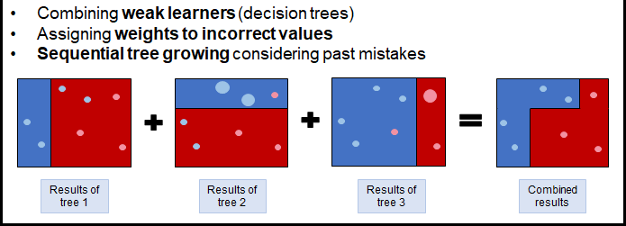

Slide 4
Extreme Gradient Boosting
1. XGBoost is a scalable, open-source machine learning library that uses gradient boosting to solve regression, classification, and ranking problems.
2. Optimized gradient boosting, which builds an ensemble of trees to correct errors in previous models. It’s known for its regularization techniques, parallel processing, and optimization, making it highly efficient.
3. Builds decision trees sequentially, with each tree correcting the residual errors of the previous trees.
4. Uses both L1 and L2 regularization to reduce overfitting.

Slide 5
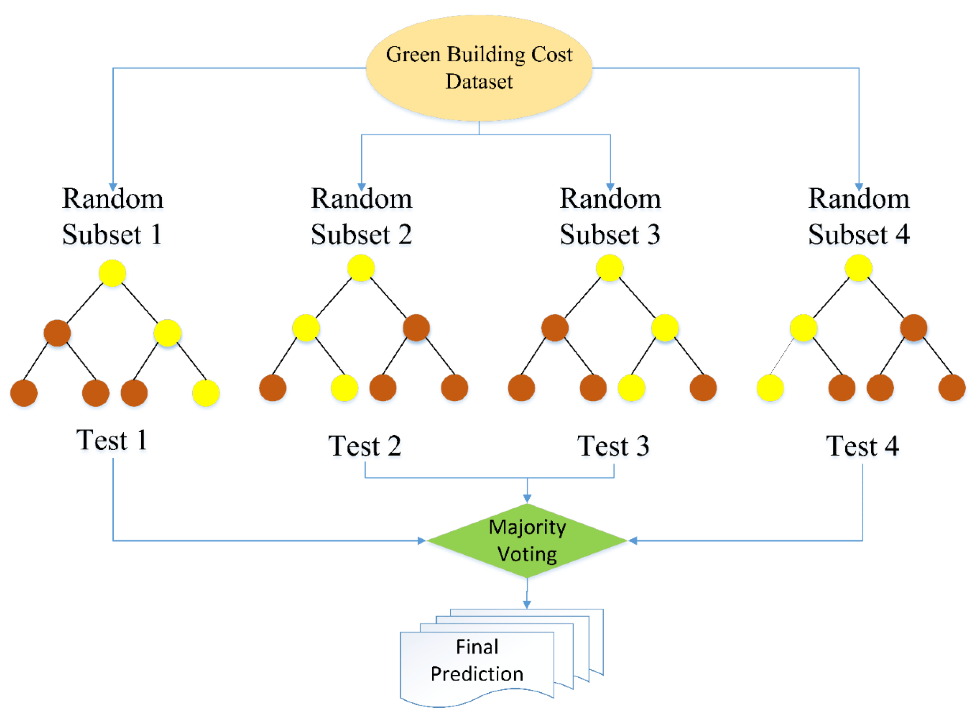

Slide 6
Light Gradient Boosting
1. Light Gradient Boosting Regressor (LightGBM Regressor) is a fast and efficient implementation of gradient boosting tailored specifically for large datasets and high dimensional data.
2. LightGBM is part of the LightGBM library developed by Microsoft and is known for its ability to handle large datasets with a low memory footprint.
3. Uses a leaf-wise growth strategy: Instead of growing all leaves at the same level, it grows the leaf with the highest error reduction potential. This can lead to deeper, more efficient trees.
4. Employs histogram-based binning to reduce computation time and memory usage.

Slide 7
